Slide 1

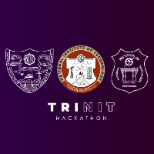

TriNIT Hackathon 3.0
Presented by
National Institute of Technology (NIT), Trichy

Slide 2
ML-03
Problem Statement Title: Image Captioning for Remote Sensing Data
Problem Description:
In the realm of computer vision and artificial intelligence, the Remote Sensing Image Captioning Dataset (RSICD) provides a unique challenge for participants to develop state-of-the-art models capable of generating accurate and descriptive captions for remote sensing images. The dataset consists of over 10,000 diverse remotely sensed images from satellites. This dataset presents a variety of scenarios and resolutions, all standardized to 224x224 pixels.. Each image comes with five sentences of descriptive captions, making it a robust foundation for training and evaluating image captioning models..
Objective:
Develop an image captioning model that can analyze and comprehend the content of remote sensing images, generating coherent and contextually relevant textual descriptions. The focus is on leveraging the RSICD dataset, with special attention to handling the unique characteristics of remote sensing images

Slide 3
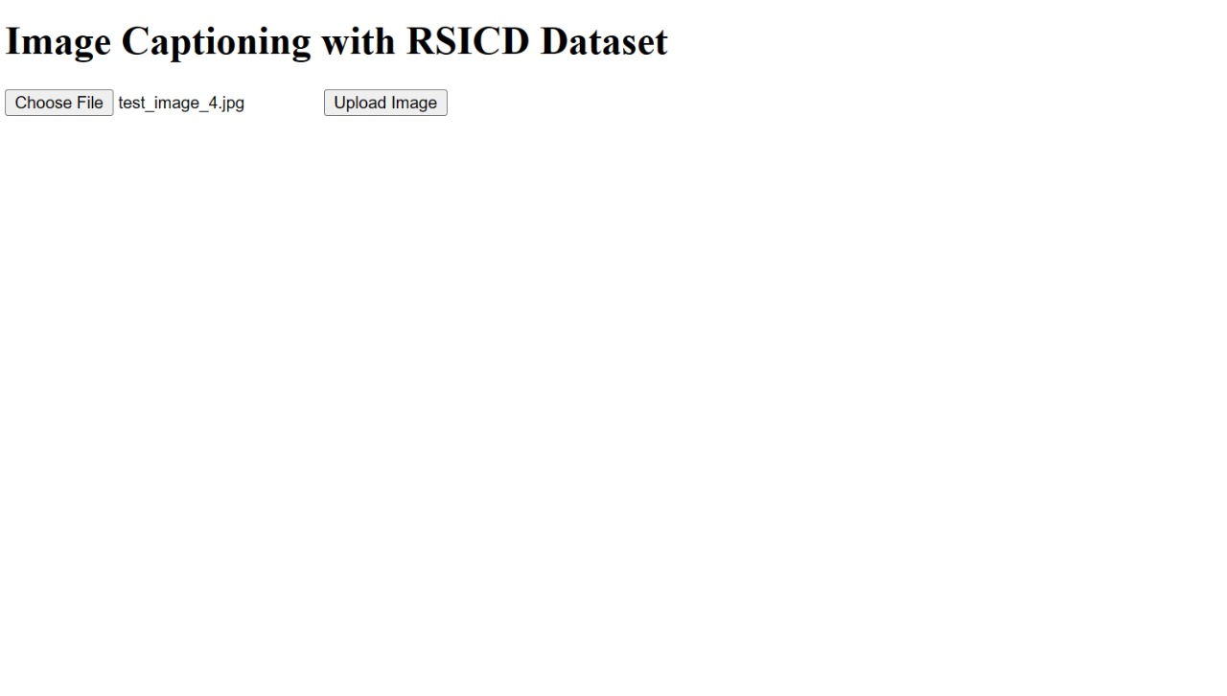
Solution Overview : Image Captioning with CNN-RNN Model
Solution Architecture:
Input: User uploads an image through the Flask-based user interface.
Processing: The uploaded image is processed by a Machine Learning model.
Model: The ML model is a combination of Convolutional Neural Network (CNN) for feature extraction and Recurrent Neural Network (RNN) for caption generation.
Output: The model generates a descriptive caption for the uploaded image.
User Interface: The caption is displayed to the user through the Flask web application.

Slide 4
Convolutional Neural Network (CNN):
CNN is used to extract high-level features from the input image.
Pre-trained CNN models (e.g., ResNet, VGG) are utilized for efficient feature extraction.
Recurrent Neural Network (RNN):
RNN is employed to generate textual descriptions based on the extracted image features.
Integration:
The output features from the CNN serve as input to the RNN.
The RNN generates a sequence of words constituting the caption.
Flask User Interface:
Users interact with the system through a user-friendly web interface developed using Flask.
The interface allows users to upload images and view the generated captions.
Conclusion:
The integration of CNN and RNN enables the generation of descriptive captions for images.
The Flask-based user interface provides an intuitive platform for users to interact with the system.

Slide 5
Thank You

